Slide 1
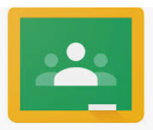
Google Classroom
Parent information guide
Wellesley Primary School

Slide 2
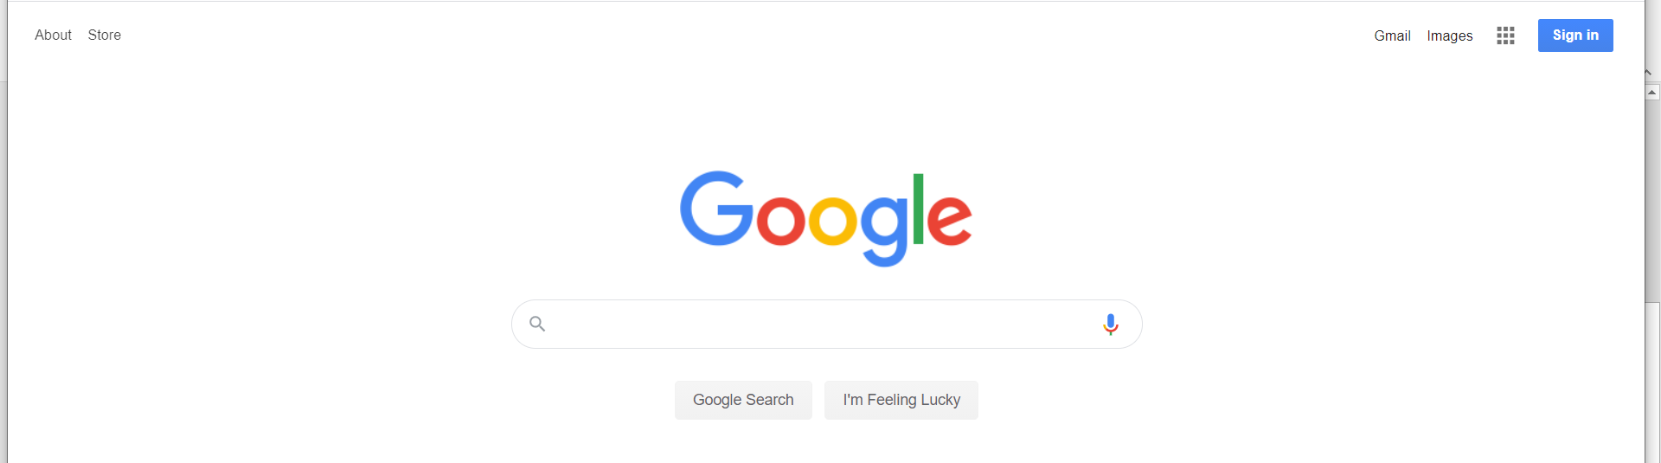
Logging in
Your children will have a login and password. This should have been sent home.
You will need to open Google Chrome.
Your child will need to sign into their account here using their user name and password.
https://classroom.google.com and click on the “Sign In” button

Slide 3
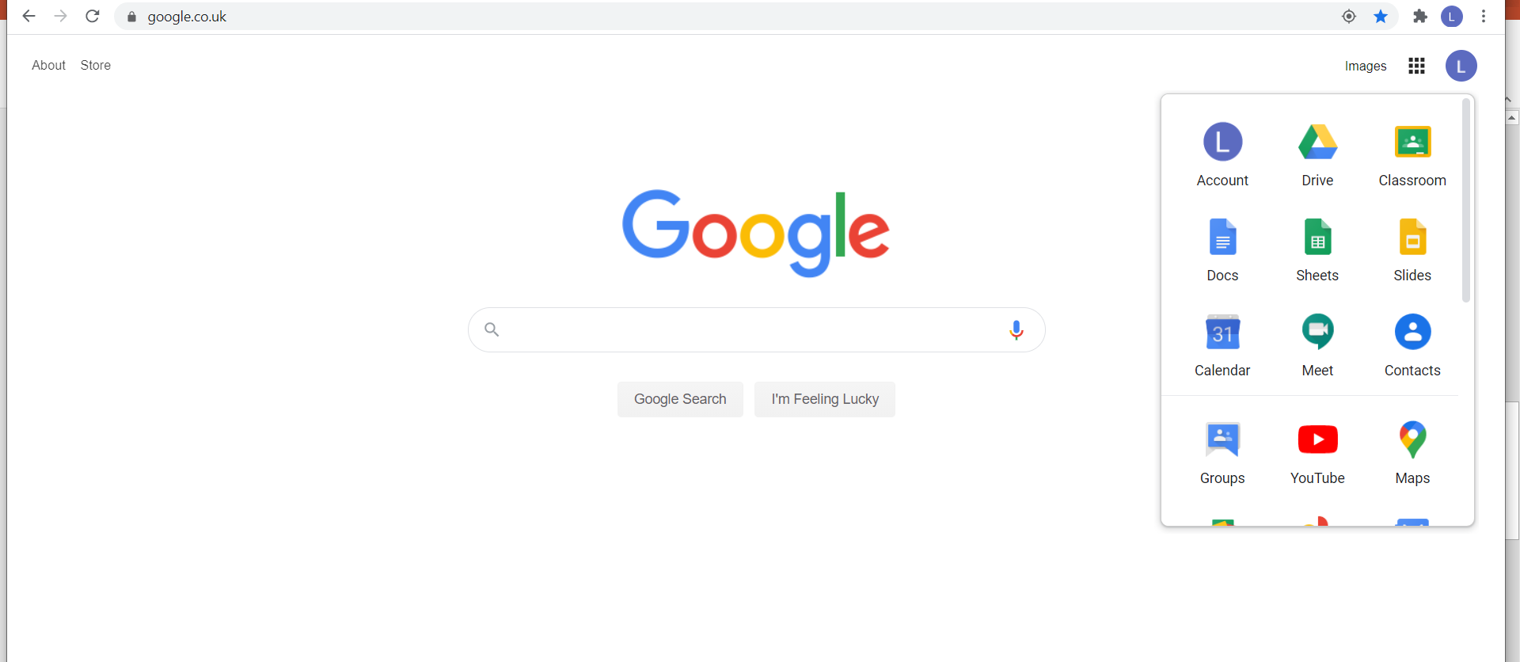
Once your child has signed in they will need to click on Google Classroom.
Once your child has signed they will need to click onto the tiles in the top right hand corner

Slide 4
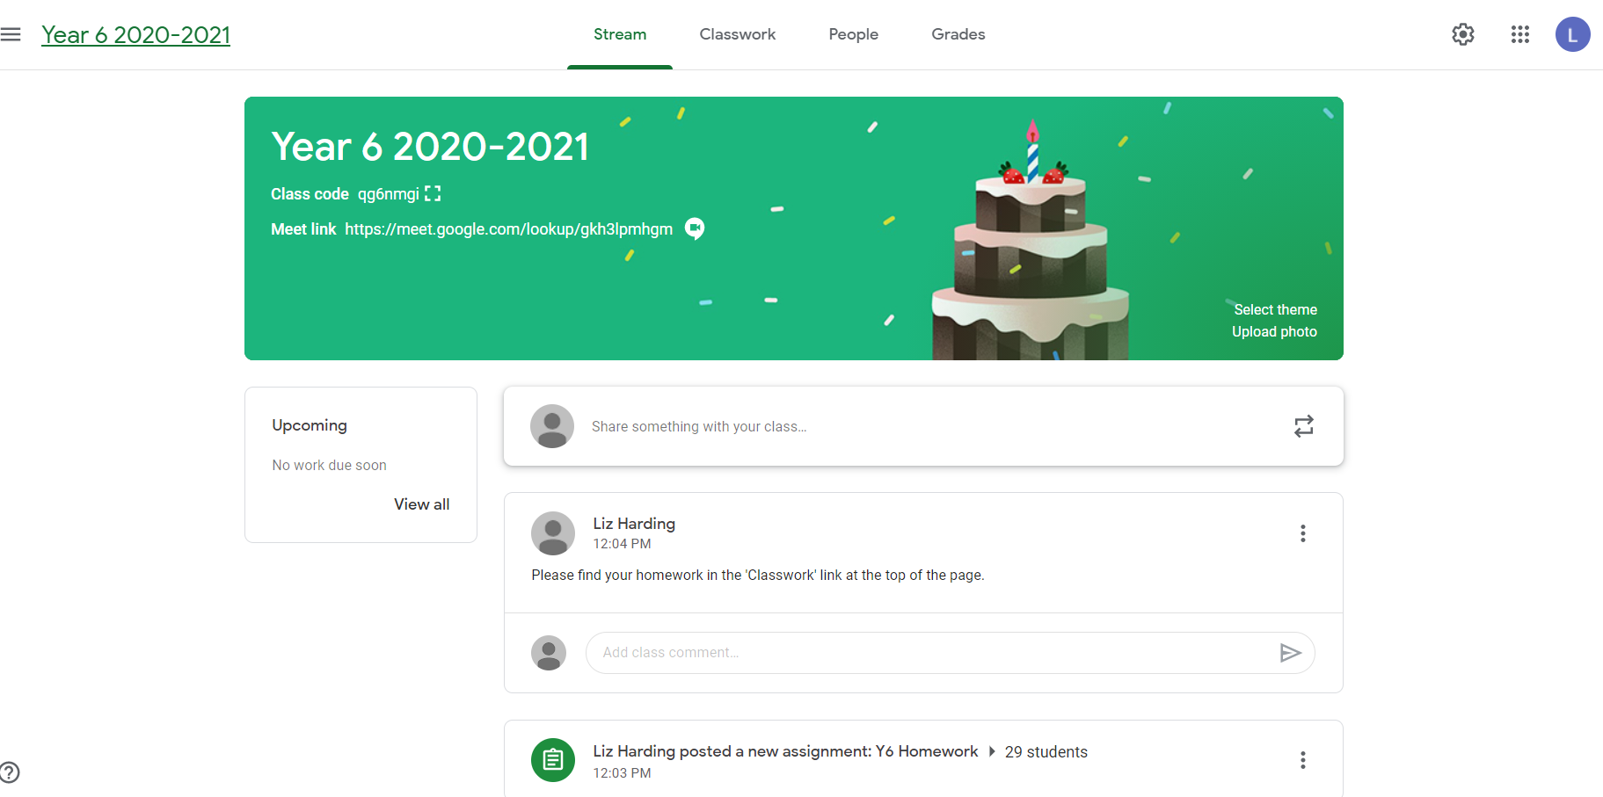
Your child should see their class page once they have logged on.
The ‘Classwork’ page will be the page you or your child will need to click on to find the work that has been set by the class teacher.
The ‘Stream’ page is so the class teacher can post information for you and your child.
This page will show you any comments or information in chronological order.

Slide 5
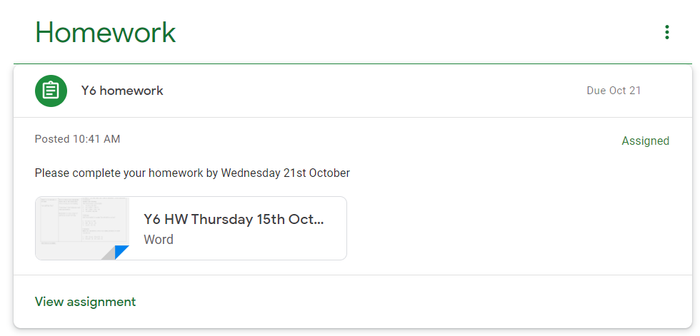
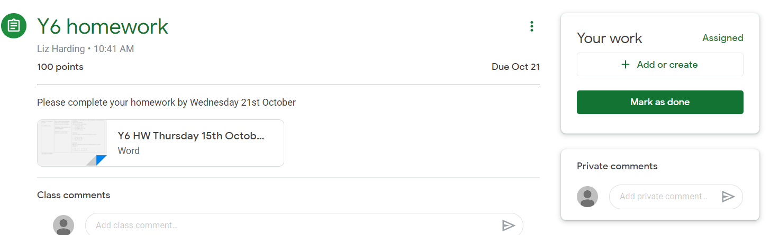
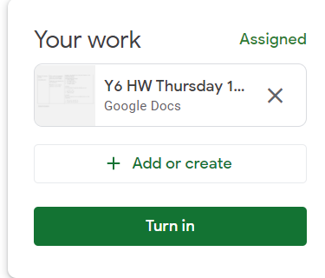
Once work is completed using Google Apps
Attaching a file from Google Docs
1. Click ‘view assignment’
2. Click ‘+ Add or create’ to attach the completed work and then mark as done.
Children can also send a private comment to the their teacher.
3. Once the completed work is attached click ‘Turn in’ so the class teacher can see it.

Slide 6
Inside their Classroom – extra information
Having entered the classroom, the children will have 3 tabs in front of them; "Stream", "Classwork" and "People".
The Stream page works similarly to a social network page. The most recent post that a teacher has added to the Google Classroom will be at the top and the oldest will be at the bottom. All messages and work assignments will be displayed upon this page.
The Classwork page is where the children should go to see and complete all of the work set for them by their teacher. This page will display all of the assignments set. To access and complete them children just need to click upon them and then follow the instructions left for them by their teacher.
  Some of the assignments will contain a document attachment using Google ‘Docs’ which the children will need to open and type responses into. The children will complete their assignment in the attachment file and then when completed click on the ‘Turn in’ button on the top right hand corner of the document. That will send a message to the teacher to tell them the work is finished and that they can go in and look at it. Please note that you do not have to save anything in ‘Docs’ it is saved automatically. You also do not have to complete the work all in one go and can return to it as many times as you wish.
  Some assignments will just contain details of a task for children to complete (sometimes there may be helpful documents and instructions attached to help them achieve this). Once the task is completed, children will need to click the ‘Mark As Done’ button next to the assignment. This lets the teacher know the task has been done even if there is no physical evidence
  Sometimes the teacher will set a task that the children will need to create their own document or upload a picture or photograph of it. To do this they will need to click on the name of the assignment followed by "Add +". A drop-down menu will appear where they can choose to create a Google document or upload a file from their computer or their online storage Google Drive. The children can go back to this document to work on it as many times as they wish until they need to submit it (all documents will save automatically). After the work has been completed or added to the assignment, then the student will need to press the "Hand In" button.
There are also several useful guides to Google classroom on Youtube if you need additional information

Slide 7
Rules for using Google Classroom
Please talk to your child about not sharing their password with anyone.
Please ensure your child uses their own username and password when logging into Google Classroom.
Please talk to your child about internet safety and if they see anything that makes them feel uncomfortable or worried they should tell a trusted adult immediately.

